Slide 1
Sentiment Analysis
Presented by
B DEVI PRASAD - 19MIS1018
NATURAL LANGUAGE PROCESSING- SWE1017
Project title: SENTIMENT ANLAYSIS ON MOVIE REVIEWS

Slide 2



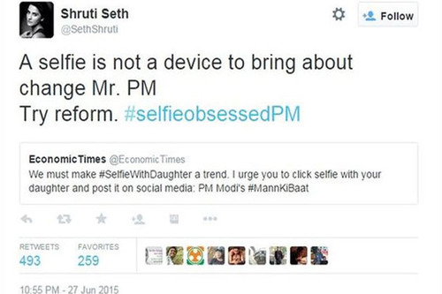
What is a Sentiment?
How can we analyze sentiments?

Slide 3

What is Sentiment Analysis?
Identify the orientation of opinion in a piece of text
Can be generalized to a wider set of emotions
The movie
was fabulous!
The movie
stars Mr. X
The movie
was horrible!

Slide 4
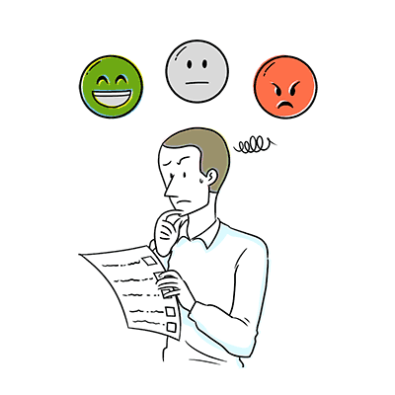
What is Sentiment Analysis?
A Sentiment may be a feeling and it is based on of attitude, emotion or a opinion on a person/object/situation
Sentiment is a subjective impression.
The study of sentiments helps to analyze the companies to crack:
Why aren’t customers buying our product/service
What is lacking in customer preference.
Analyze the subjective data
Perceptions, misperceptions and analysis of tweets/comments

Slide 5
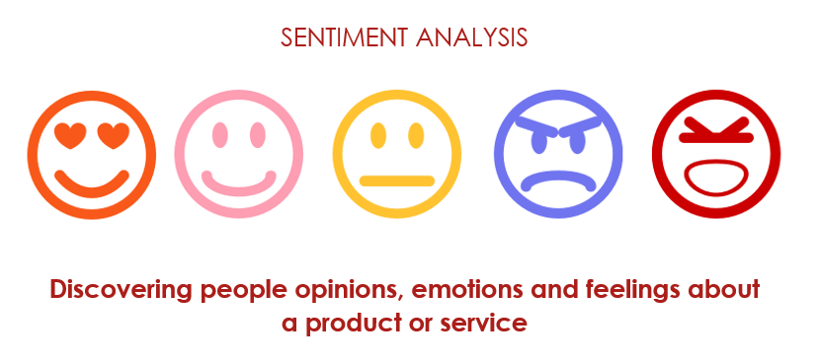
Applications of Sentiment Analysis
To study Open-ended question responses
Customer surveys
Opinion polling surveys
Public feed back and Social trends
Consumer satisfaction analysis
Employee perceptions
Public talks on a product/service/movie

Slide 6
Motivation
Knowing sentiment is a very natural ability of a human being.
Can a machine be trained to do it?
SA aims at getting sentiment-related knowledge especially from the huge amount of information on the internet
Can be generally used to understand opinion in a set of documents

Slide 7
Tripod of Sentiment Analysis
Cognitive Science
Sentiment Analysis
Machine Learning
Machine Learning
Natural Language Processing
Natural Language Processing

Slide 8
Contents :
Challenges
Lexical
Resources
Subjectivity
detection
SA
Approaches
Applications

Slide 9
SentiWordNet
Lexical resource for sentiment analysis
Built on the top of WordNet synsets
Attaches sentiment-related information with synsets

Slide 10
Quantifying sentiment
Positive
Negative
Subjective Polarity
Term sense position
Objective Polarity
Each term has a Positive, Negative and Objective score. The scores sum to one.

Slide 11
Building SentiWordNet
  Ln, Lo, Lp are the three seed sets
  Iteratively expand the seed sets through K steps
  Train the classifier for the expanded sets

Slide 12
Expansion of seed sets
also-see
antonymy
Ln
Lp
The sets at the end of kth step are called Tr(k,p) and Tr(k,n)
Tr(k,o) is the set that is not present in Tr(k,p) and Tr(k,n)

Slide 13
Committee of classifiers
Train a committee of classifiers of different types and different K-values for the given data
Observations:
  Low values of K give high precision and low recall
  Accuracy in determining positivity or negativity, however, remains almost constant

Slide 14
WordNet Affect
Similar to SentiWordNet (an earlier work)
WordNet-Affect: WordNet + annotated affective concepts in hierarchical order
Hierarchy called ‘affective domain labels’
  behaviour
  personality
  cognitive state

Slide 15
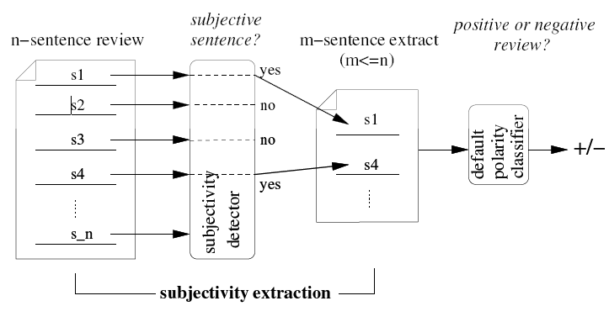
Subjectivity detection
Aim: To extract subjective portions of text
Algorithm used: Minimum cut algorithm

Slide 16


Constructing the graph
Why graphs?
Nodes and edges?
Individual Scores
Association scores
Why graphs?
Nodes and edges?
Individual Scores
Association scores
Why graphs?
Nodes and edges?
Individual Scores
Association scores
Why graphs?
Nodes and edges?
Individual Scores
Association scores
To model item-specific
and pairwise information
independently.
Nodes: Sentences of
the document and source & sink
Source & sink represent
the two classes of sentences
Edges: Weighted with
either of the two scores
Prediction whether
the sentence is subjective or not
Ind_{sub}(s_{i})=
Prediction whether two
sentences should have
the same subjectivity level
  T : Threshold – maximum distance upto
  which sentences may be considered proximal
  f: The decaying function
  i, j : Position numbers

Slide 17
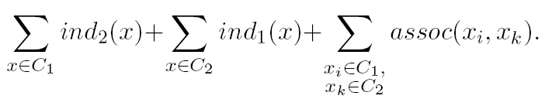
Constructing the graph
Build an undirected graph G with vertices {v1, v2…,s, t} (sentences and s,t)
Add edges (s, v_{i}) each with weight ind₁(x_{i})
Add edges (t, v_{i}) each with weight ind₂(x_{i})
Add edges (v_{i}, v_{k}) with weight assoc (v_{i}, v_{k})
Partition cost:

Slide 18
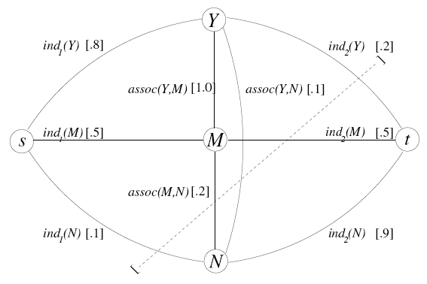
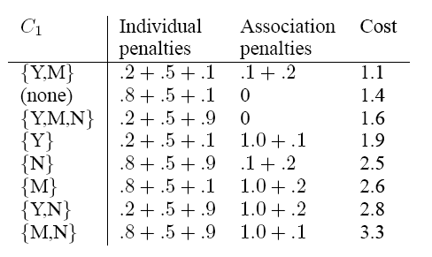
Example
Sample cuts:

Slide 19
Results (1/2)
Naïve Bayes, no extraction : 82.8%
Naïve Bayes, subjective extraction : 86.4%
Naïve Bayes, ‘flipped experiment’ : 71 %
Subjectivity
detector
Subjective
POLARITY CLASSIFIER
Document
Document
Objective

Slide 20
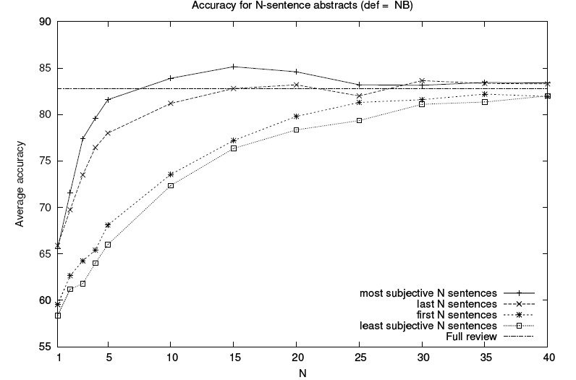
Results (2/2)

Slide 21
Approach 1: Using adjectives
Many adjectives have high sentiment value
  A ‘beautiful’ bag
  A ‘wooden’ bench
  An ‘embarrassing’ performance
An idea would be to augment this polarity information to adjectives in the WordNet

Slide 22


Setup
Two anchor words (extremes of the polarity spectrum) were chosen
PMI of adjectives with respect to these adjectives is calculated
Polarity Score (W)= PMI(W,excellent) – PMI (W, poor)
word
PMI
PMI
excellent
poor

Slide 23
Experimentation
K-means clustering algorithm used on the basis of polarity scores
The clusters contain words with similar polarities
These words can be linked using an ‘isopolarity link’ in WordNet

Slide 24
Results
Three clusters seen
Major words were with negative polarity scores
The obscure words were removed by selecting adjectives with familiarity count of 3
  the ones that are not very common

Slide 25
Approach 2: Using Adverb-Adjective Combinations (AACs)
Calculate sentiment value based on the effect of adverbs on adjectives
Linguistic ideas:
Adverbs of affirmation: certainly
Adverbs of doubt: possibly
Strong intensifying adverbs: extremely
Weak intensifying adverbs: scarcely
Negation and Minimizers: never

Slide 26
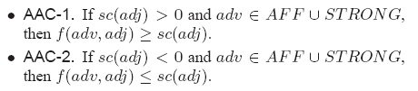
Moving towards computation…
Based on type of adverb, the score of the resultant AAC will be affected
Example of an axiom:
Example : ‘extremely good’ is more positive than ‘good’

Slide 27
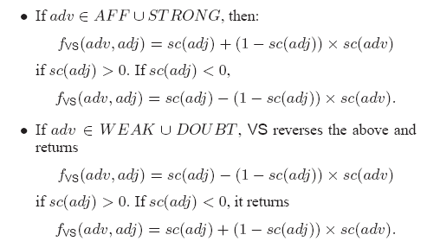
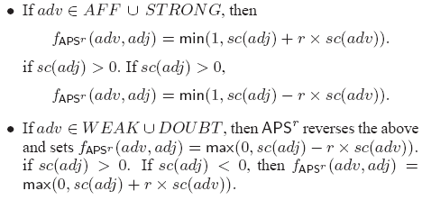
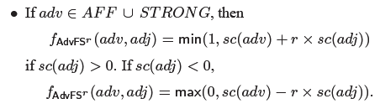
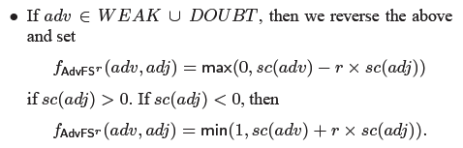
AAC Scoring Algorithms
Variable Scoring Algorithm
Adjective Priority Scoring Algorithm
Adverb first scoring algorithm

Slide 28

Scoring the sentiment on a topic
Rel (t) : Sentences in d that reference to topic t
s : Sentence is Rel (t)
Appl⁺(s) : AACs with positive score in s
Appl⁻(s) : AACs with negative score in s
Return strength =

Slide 29
Findings
APS^{r} with r=0.35 worked the best (Better correlation with human subject)
  Adjectives are more important than adverbs in terms of sentiment
AACs give better precision and recall as compared to only adjectives

Slide 30
Approach 3: Subject-based SA
Examples:
The horse bolted.
The movie lacks a good story.

Slide 31
Lexicon
subj. bolt
Argument that receives the sentiment (subj./obj.)
b VB bolt subj
subj. lack obj.
b VB lack obj ~subj
Argument that receives the sentiment (subj./obj.)
Argument that sends the sentiment (subj./obj.)

Slide 32
Lexicon
Also allows ‘\S+’ characters
Similar to regular expressions
E.g. to put \S+ to risk
  The favorability of the subject depends on the favorability of ‘\S+’.

Slide 33
Example
The movie lacks a good story.
The movie lacks \S+.
Lexicon :
Steps :
Consider a context window of upto five words
Shallow parse the sentence
Step-by-step calculate the sentiment value based on lexicon and by adding ‘\S+’ characters at each step
G JJ good obj.
B VB lack obj ~subj.

Slide 34
Results
 | Description | Precision | Recall
Benchmark corpus | Mixed statements | 94.3% | 28%
Open Test corpus | Reviews of a camera | 94% | 24%

Slide 35
Types of Sentiment Analysis
Fine-grained sentiment analysis: This depends on the polarity based. This category can be designed as very positive, positive, neutral, negative, very negative. The rating is done on the scale 1 to 5. If the rating is 5 then it is very positive, 2 then negative and 3 then neutral.
Emotion detection: The sentiment happy, sad, anger, upset, jolly, pleasant, and so on come under emotion detection. It is also known as a lexicon method of sentiment analysis.

Slide 36
Aspect based sentiment analysis: It focuses on a particular aspect like for instance, if a person wants to check the feature of the cell phone then it checks the aspect such as battery, screen, camera quality then aspect based is used.
Multilingual sentiment analysis: Multilingual consists of different languages where the classification needs to be done as positive, negative, and neutral. This is highly challenging and comparatively difficult

Slide 37
How does Sentiment Analysis work?
There are three approaches used:
Rule-based approach: Over here, the lexicon method, tokenization, parsing comes in the rule-based. The approach is that counts the number of positive and negative words in the given dataset. If the number of positive words is greater than the negative words then the sentiment is positive else vice-versa.
Automatic Approach: This approach works on the machine learning technique. Firstly, the datasets are trained and predictive analysis is done. The next process is the extraction of words from the text is done. This text extraction can be done using different techniques such as Naive Bayes, Linear Regression, Support Vector, Deep Learning like this machine learning techniques are used.
Hybrid Approach: It is the combination of both the above approaches i.e. rule-based and automatic approach. The surplus is that the accuracy is high compared to the other two approaches.

Slide 38
Applications
Sentiment Analysis has a wide range of applications as:
Social Media: If for instance the comments on social media side as Instagram, over here all the reviews are analyzed and categorized as positive, negative, and neutral.
Customer Service: In the play store, all the comments in the form of 1 to 5 are done with the help of sentiment analysis approaches.
Marketing Sector: In the marketing area where a particular product needs to be reviewed as good or bad.
Reviewer side: All the reviewers will have a look at the comments and will check and give the overall review of the product.

Slide 39
Challenges of Sentiment Analysis
There are major challenges in sentiment analysis approach:
If the data is in the form of a tone, then it becomes really difficult to detect whether the comment is pessimist or optimist.
If the data is in the form of emoji, then you need to detect whether it is good or bad.
Even the ironic, sarcastic, comparing comments detection is really hard.
Comparing a neutral statement is a big task.

Slide 40
Sentiment analysis is powered by smart language algorithms. In a nutshell, it works by identifying and quantifying the positive and negative feelings within our words.
This kind of subtle wordplay can often be lost within the flow of a busy live chat service. Agents are trying their hardest to respond quickly and accurately, and deeper analysis is difficult.
So, when used to support your chatting customers, sentiment analysis provides insight into the real mood behind the messages. This sounds cool, but is it useful? Here’s a handy list outlining some of the top benefits of sentiment analysis in live chat software.

Slide 41
Applications
Review-related analysis
Developing ‘hate mail filters’ analogous to ‘spam mail filters’
Question-answering (Opinion-oriented questions may involve different treatment)

Slide 42
Conclusion & Future Work
Lexical Resources have been developed to capture sentiment-related nature
Subjective extracts provide a better accuracy of sentiment prediction
Several approaches use algorithms like Naïve Bayes, clustering, etc. to perform sentiment analysis
The cognitive angle to Sentiment Analysis can be explored in the future

